Slide 1

Fishing together
Group 5 Final Project Update
賀品涵、陳敬諺、邱子耘

Slide 2
Proposal
Functions
Social functions：
Chatting
Competition
Cooperation
Exchange collections
Basic：
Fishing
Baiting
Casting
Reeling
Fishing net / catching fish
Fish movement
Swim
Bite
Struggle
Tools
Types of fishing rod
Types of fishing buoy
Collection & Record
Different maps (sea/river)

Slide 3
Complete
Action
fly fishing
reeling (sound)
get fish (sound)
Terrain
river
pond nearby waterfall
ice

Slide 4
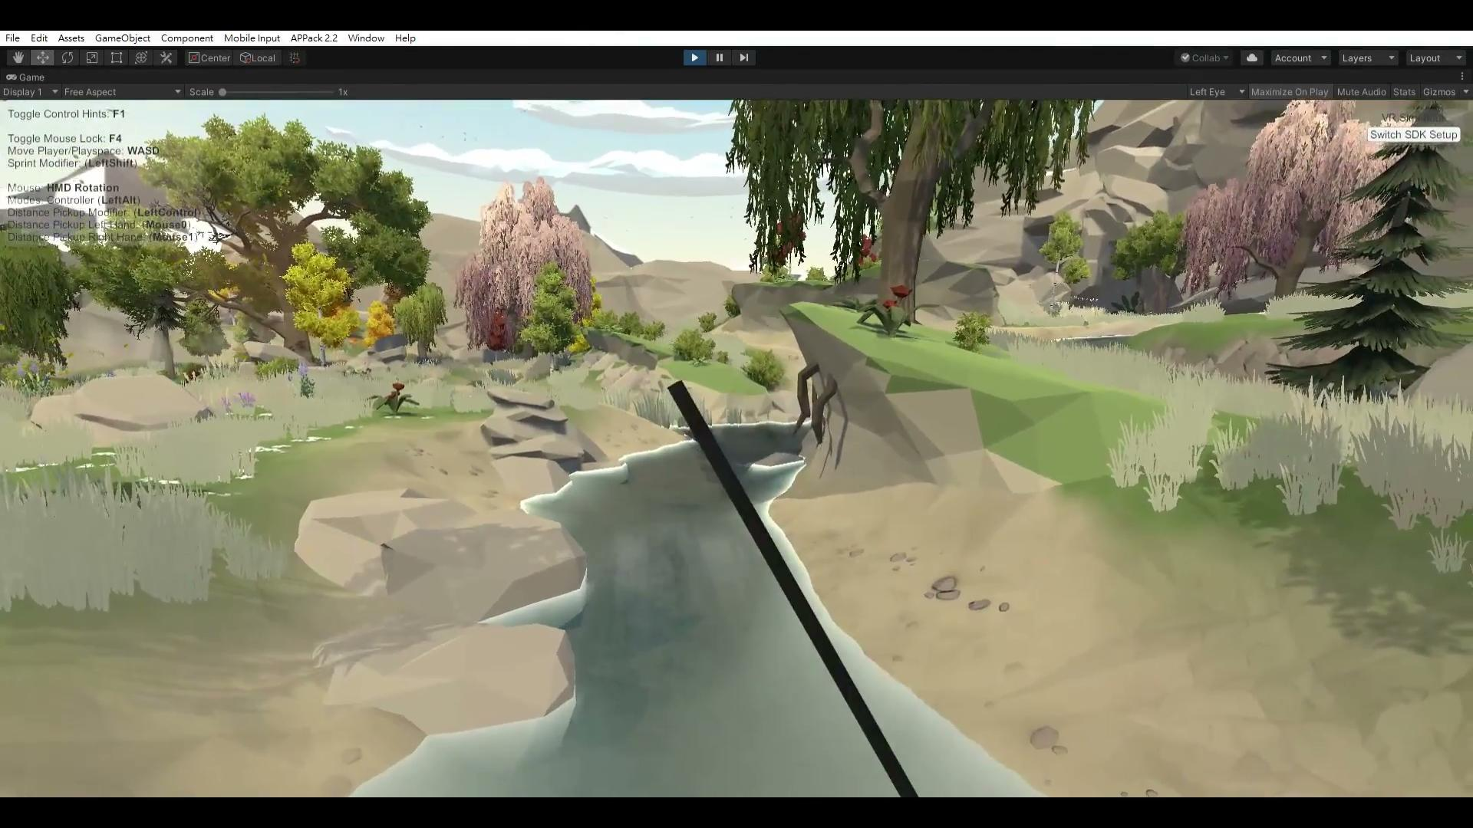
Complete - Action
Fly Fishing

Slide 5
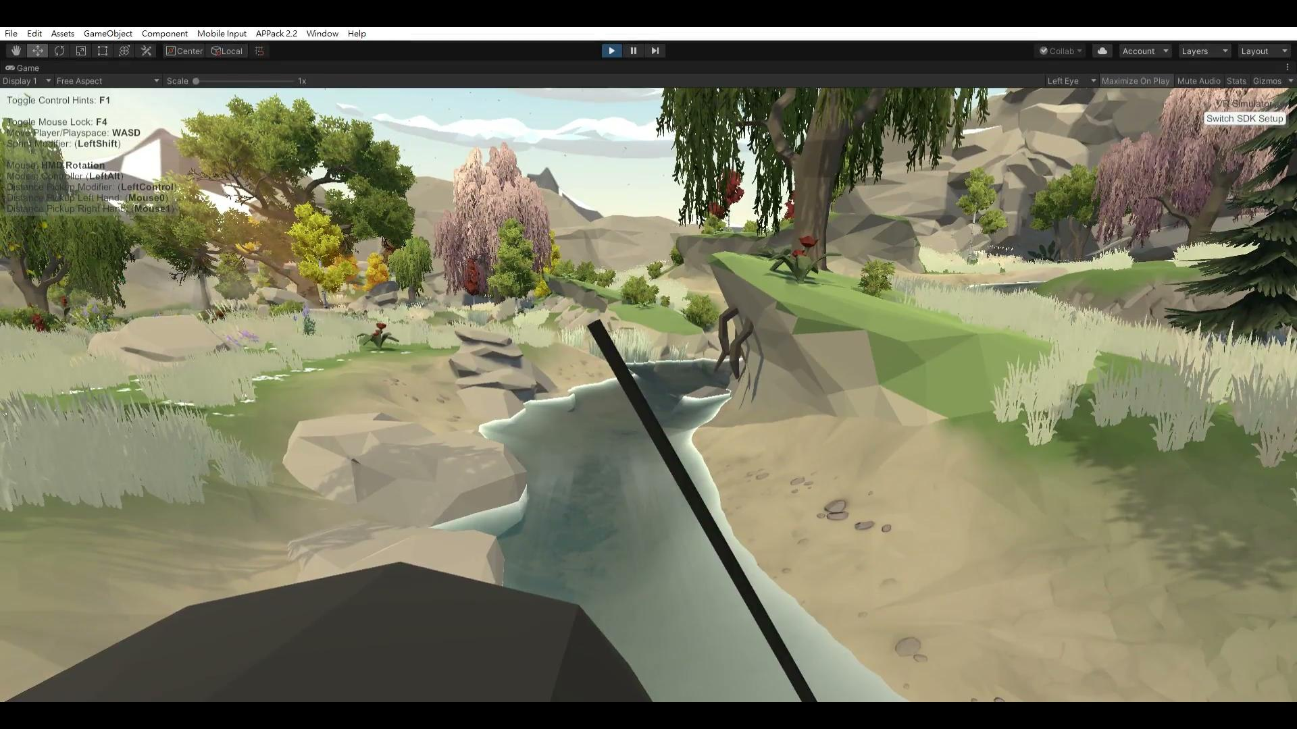
Complete - Action
Reeling

Slide 6
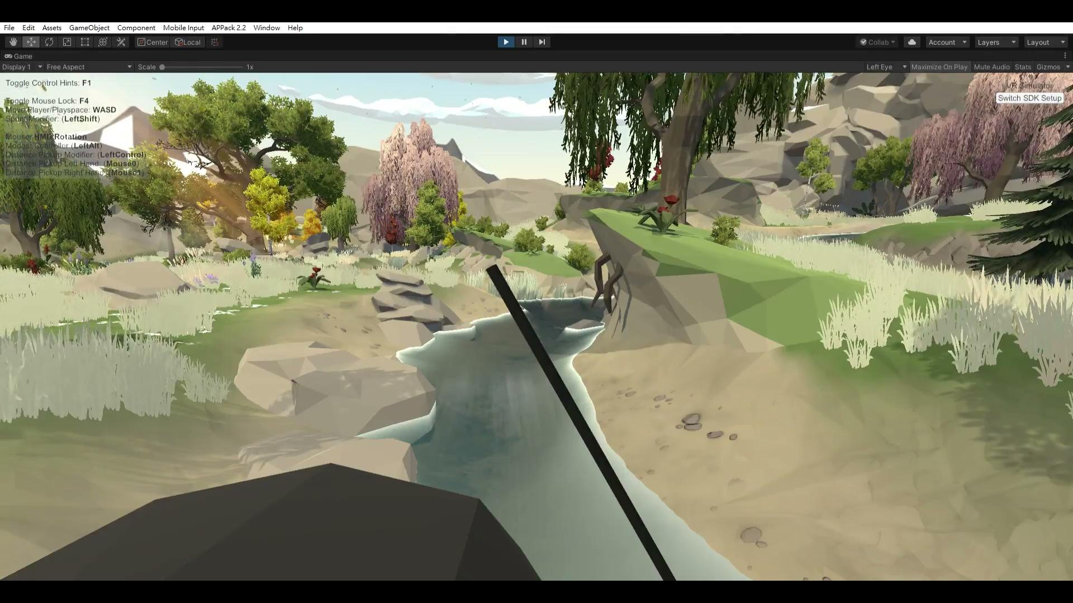
Complete - Action
Getting Fish

Slide 7

Complete - Action
Getting Fish

Slide 8
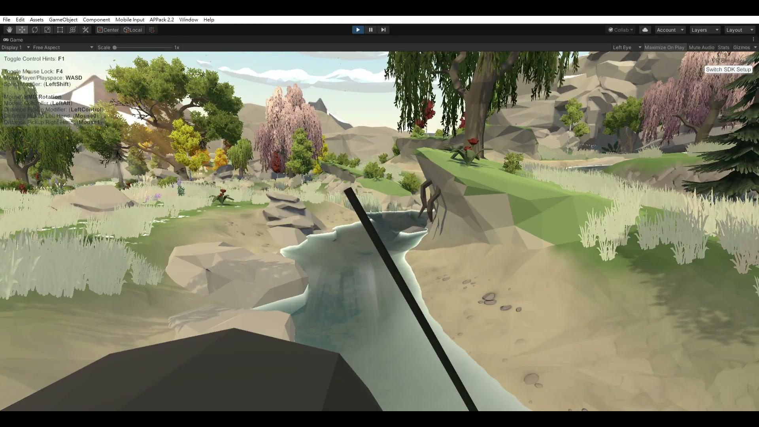
Complete - Action
Failed

Slide 9
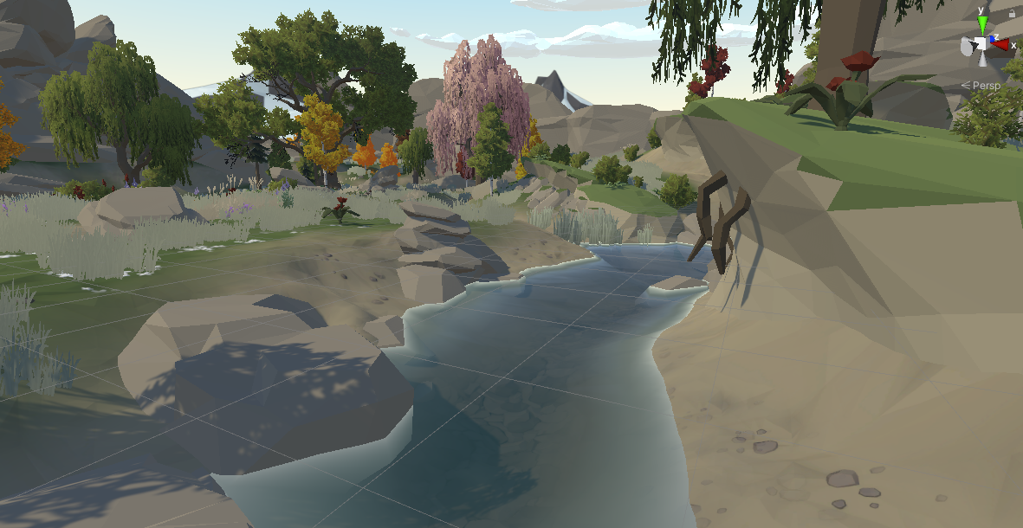
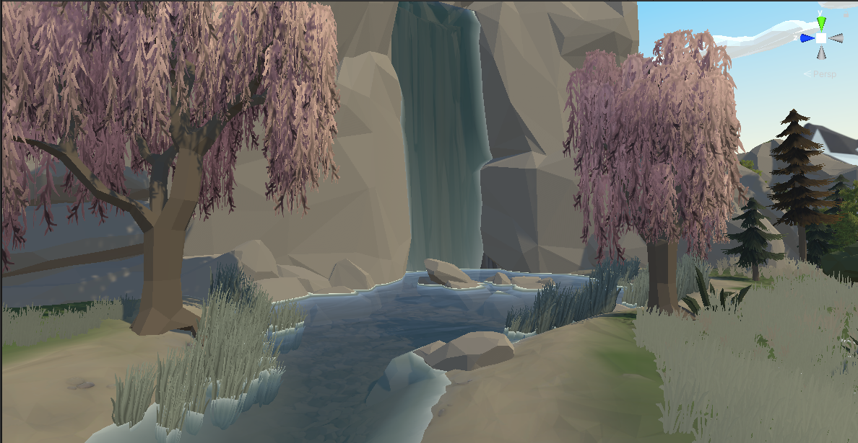
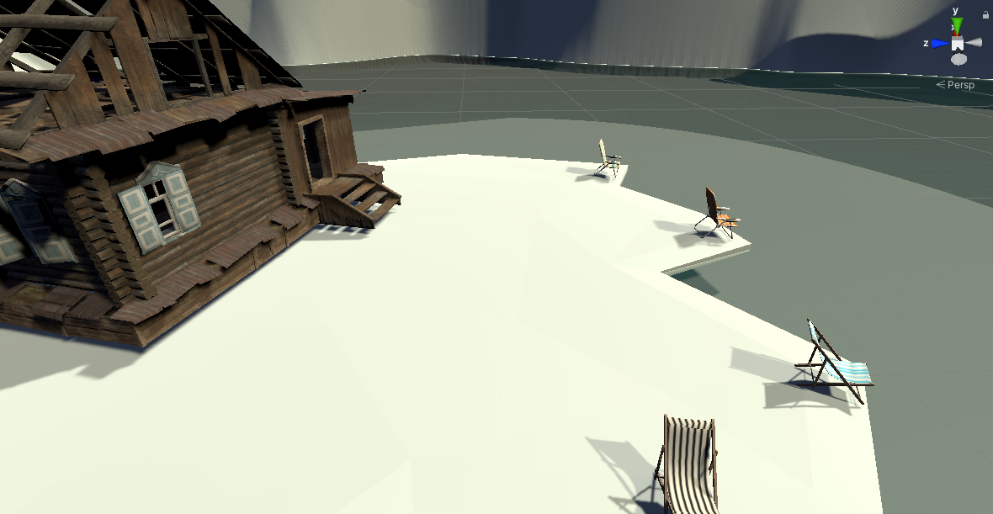
Complete - Terrain
river
b. pond nearby waterfall
c. ice

Slide 10
Improvement
Social Function
Share music
Comment
Helping others
Move
More Kinds of Fish
More Terrains

Slide 11
Q&A

Slide 12
Concepts
Fishing
Social
VR

Slide 13
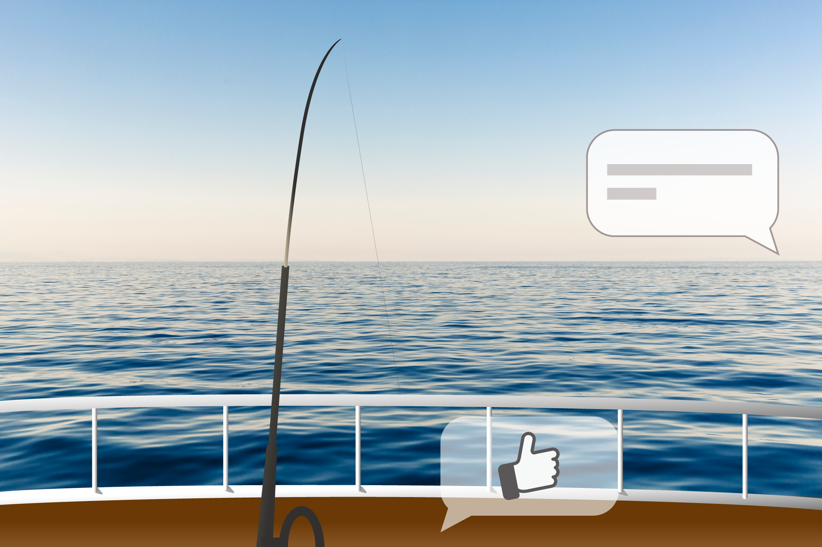

Slide 14
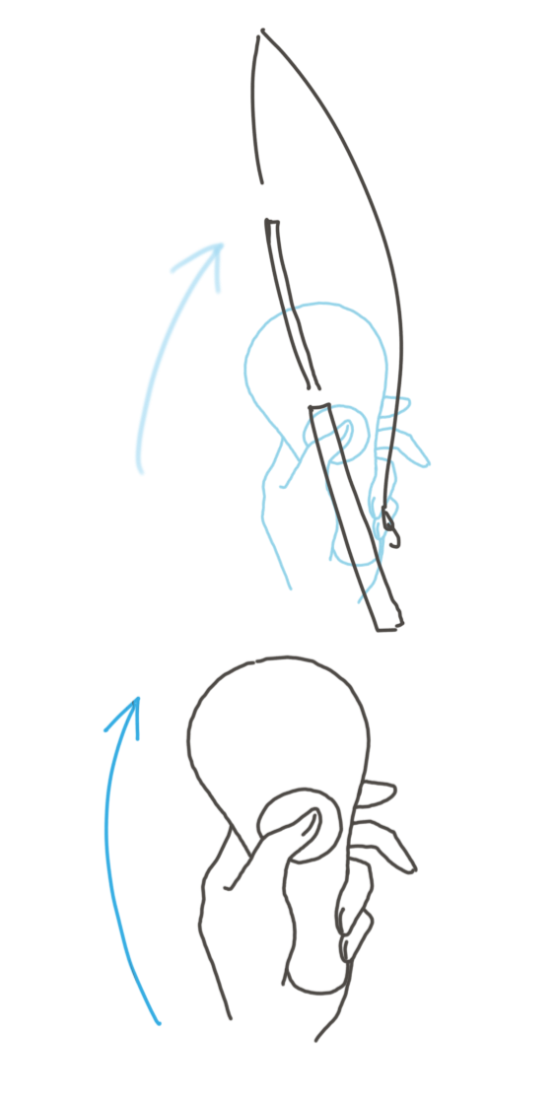
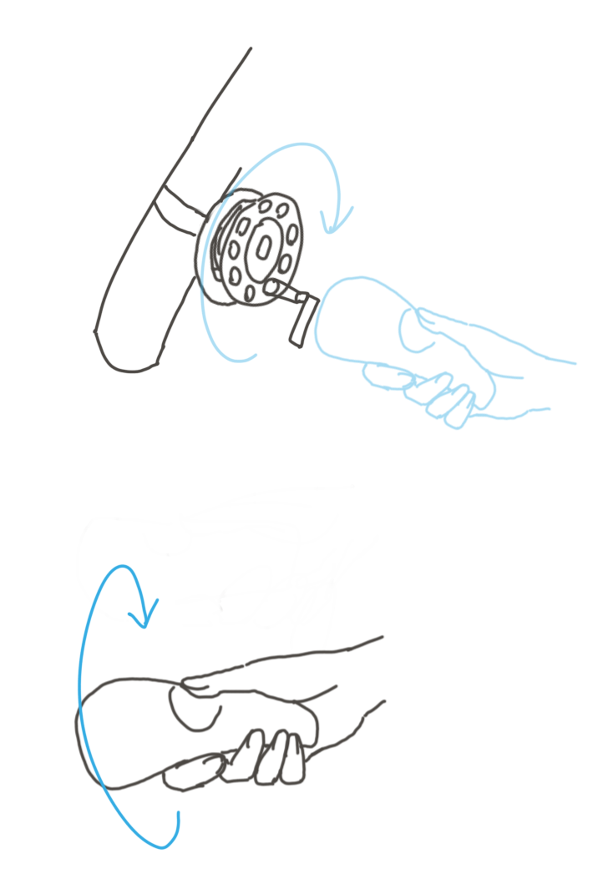
Basic functions Fishing simulation
Casting
Reeling
因滑鼠操作上要做出這些動作較為困難
我們暫時以按鍵輸入取代手把移動軌跡輸入

Slide 15
Basic functions Collection & Record
Fish collection:
Show all kinds of fishes the player has caught
Receive special rewards when complete part of the collection
Record:
Record the biggest size of fish the player has caught

Slide 16
Basic functions Different maps
Codex : Choose maps and see number of online users
Fishing places :
Sea
River
Private room : Play with friends only
Different type of fish in different places
Collection : A fish tank that shows all the fishes a player has caught
Tool setting : Choose baits / rods / buoys

Slide 17
Social functions Competition
Multiple players
Timing
Allow players to choose maps, time limit or rules.

Slide 18
Social functions Cooperation
Multiple players
When a player meets a big fish that is difficult to caught,
other players near him/her can help.

Slide 19
Social functions Exchange
Exchange fish with other players to complete the collection

